Slide 1
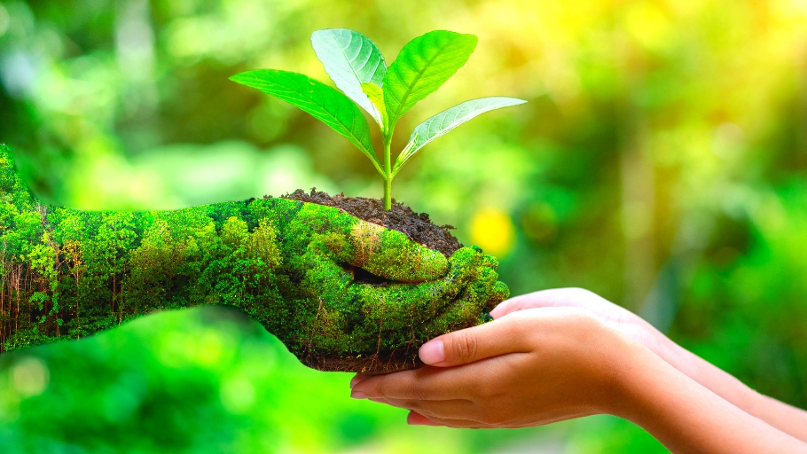
ECO-FRIENDLY
PETRA BARIŠIC 7 A

Slide 2
​
GO ECO-FRIENDLY
Reuse, repair, recycle
Use public transport
Use less plastic
Grow your own food
Use electric car
Save water and electricity
If you don’t know how to start, come on our eco-friendly action. It starts on 6th June and it lasts until 11th June. We are going to make our own garden with vegetables and fruits, we are going to clean beaches, donate old appliances to charities and help our Earth on many other ways. There is prize game at the end, winner wins solar panels. COME ON, GO ECO-FRIENDLY WITH US !
Don’t keep tap running, while washing your teeth.
Turn off the light when you are not using them

